Slide 1
Public Key Cryptography
RSA

Slide 2
Public Key Cryptography
Encryption and decryption is carried out using two different keys.
The two keys in such a key pair are referred to as the public key and the private key.
  This solves one of the most inconvenient problems associated with symmetric-key cryptography — the problem of key distribution.
With public key cryptography, all parties interested in secure communications can publish their public keys.

Slide 3

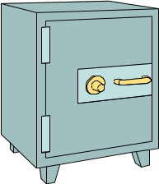

Public and Private keys…
Anything encrypted with the private key can only be decrypted with the public key. And vice versa
Since the private key is known only to the owner, this is very powerful.
Data
Encrypt
Decrypt
Data

Slide 4
Public Key Cryptography…
One of the encryption or decryption key is made public depends on the use of the key.
  If Abe wants to send a confidential message to Selam
    He encrypts the message using Selam’s public key
    Send the message
    Selam will then decode it using her own private key
  On the other hand, if Selam needs to make sure that a message sent by Abe really comes from him, how can she make that?

Slide 5
Public Key Cryptography…
Using digital signature
  Abe has to first encrypt a digital signature using his private key.
  Then encrypt the message (signature included) with Selam’s public key.
  Send the encrypted message to Selam.
  Selam decrypts the message using her private key.
  Selam then decrypts the signature using Abe’s public key.
  If successful, she insures that it comes from Abe.

Slide 6
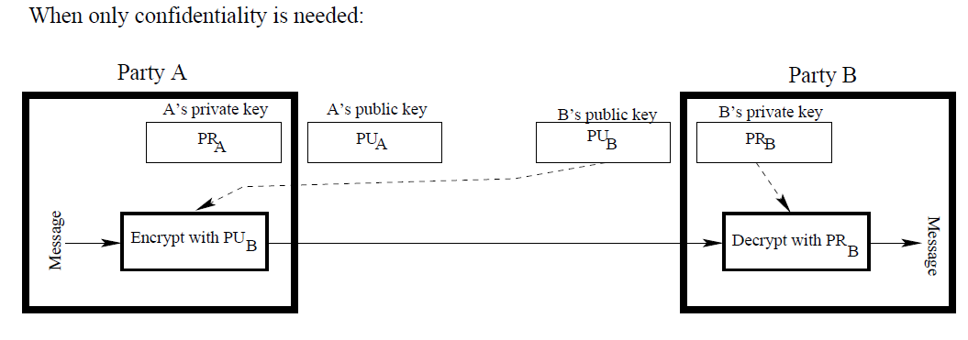
Public Key Cryptography…
Party A, if wanting to communicate confidentially with party B, can encrypt a message using B’s publicly available key.
Such a communication would only be decipherable by B as only B would have access to the corresponding private key.
Party A wants to send a message to Party B

Slide 7
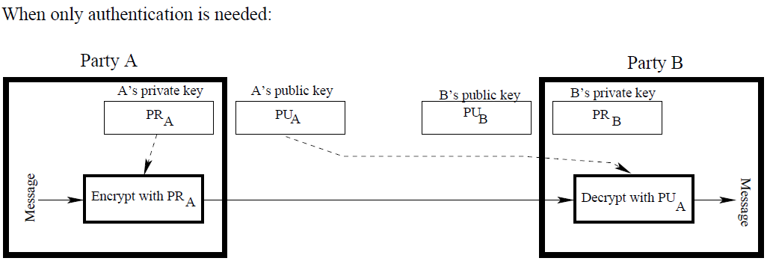
Public Key Cryptography…
Party A, if wanting to send an authenticated message to party B, would encrypt the message with A’s own private key.
Since this message would only be decipherable with A’s public key, that would establish the authenticity of the message — meaning that A was indeed the source of the message.
Party A wants to send a message to Party B

Slide 8
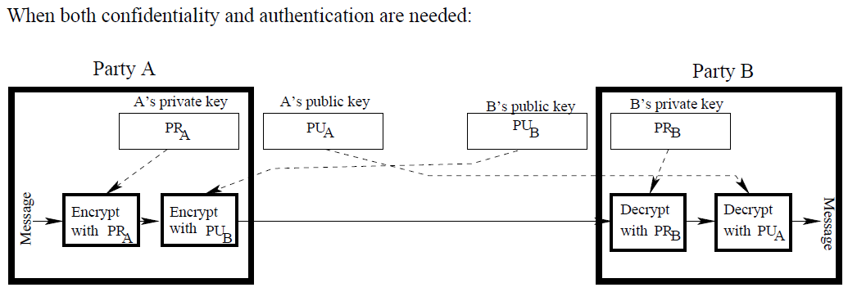
Public Key Cryptography…
The communication link shows how public-key encryption can be used to provide both confidentiality and authentication at the same time.
  Confidentiality means that we want to protect a message from eavesdroppers.
  Authentication means that the recipient needs a guarantee as to the identity of the sender.

Slide 9
Public Key Cryptography…
A’s public and private keys are designated PU_{A} and PR_{A}.
B’s public and private keys are designated PU_{B} and PR_{B}.
As shown above, let’s say that A wants to send a message M to B with both authentication and confidentiality.
The processing steps undertaken by A to convert M into its encrypted form C that can be placed on the wire are:
C = E (PU_{B}, E (PR_{A}, M))
  where E() stands for encryption.
The processing steps undertaken by B to recover M from C are
M = D(PU_{A}, D(PR_{B}, C))
  where D() stands for decryption.

Slide 10
Public Key Cryptography: classification
We can classify the use of public-key cryptosystems into three categories:
  Encryption/decryption: The sender encrypts a message with the recipient's public key.
  Digital signature: The sender "signs" a message with its private key.
    Signing is achieved by a cryptographic algorithm applied to the message or to a small block of data that is a function of the message.
  Key exchange: Two sides cooperate to exchange a session key.
    Several different approaches are possible, involving the private key(s) of one or both parties.

Slide 11
Requirements for Public-Key Cryptography
It is computationally easy for a party B to generate a pair (public key PU_{b}, private key PR_{b}).
It is computationally easy for a sender A, knowing the public key and the message to be encrypted, M, to generate the corresponding ciphertext:
C = E(PU_{b}, M)
3. It is computationally easy for the receiver B to decrypt the resulting ciphertext using the private key to recover the original message:
M = D(PR_{b}, C) = D[PR_{b}, E(PU_{b}, M)]
4. It is computationally infeasible for an adversary, knowing the public key, PU_{b}, to determine the private key, PR_{b}.
5. It is computationally infeasible for an adversary, knowing the public key, PU_{b}, and a ciphertext, C, to recover the original message, M.

Slide 12
Types of Public Key Cryptography
Diffie-Hellman
RSA
ElGamal
Elliptic curve …..

Slide 13
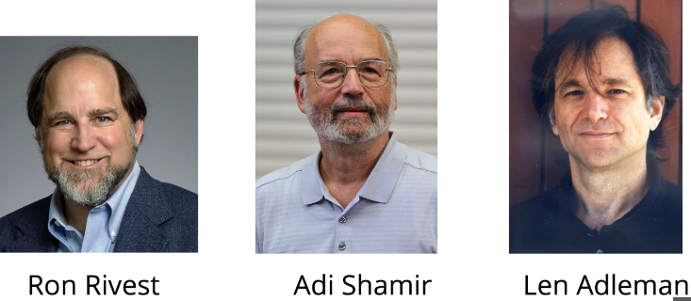
RSA
RSA is from Rivesh, Shamir and Aldermen
Principle: No mathematical method is yet known to efficiently find the prime factors of large numbers.
In RSA, the private and public keys are constructed from very large prime numbers (consists of hundred of decimal digits) One of the keys can be made public.
Breaking RSA is equivalent to finding the prime factors: this is know to be computationally infeasible. (NP-hard)
It is only the person who has produced the keys from the prime number can easily decrypt the messages.

Slide 14
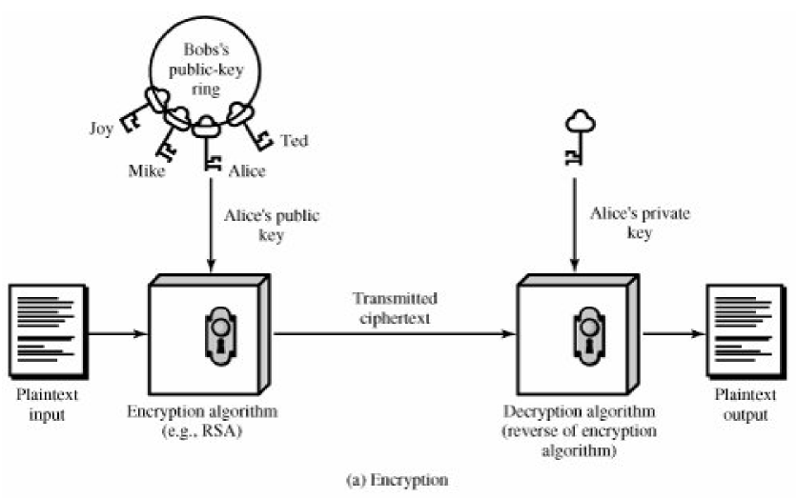
Encryption

Slide 15
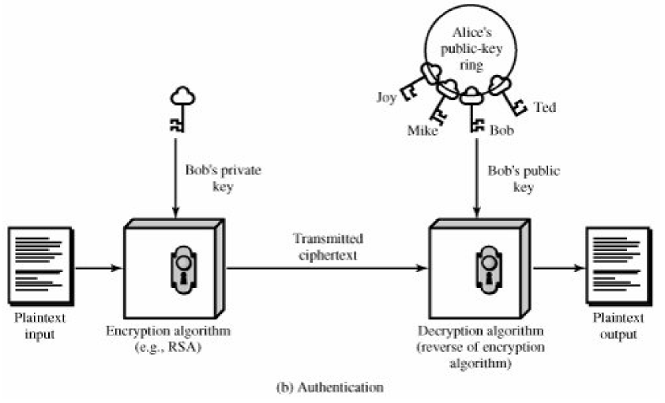
Authentication

Slide 16
Asymmetric RSA
The RSA algorithm
  Used for both public key encryption and digital signatures.
  Security is based on the difficulty of factoring large integers.
Major Activities
  Key Generation
  Encryption
  Digital signature
  Decryption
  Signature verification

Slide 17
Asymmetric RSA
Key Generation Algorithm
Generate two large random primes, p and q
Compute n = pq and (φ) phi = (p-1)(q-1)
Choose an integer e, 1 < e < φ, such that gcd(e, phi) = 1
Compute the secret exponent d, 1 < d < φ, such that
d = e⁻¹ mod φ , i.e. φ divides (ed-1)
or d = (φk+1)/e, where k = 0, 1, 2, 3…..
The public key is (n, e) and the private key is (n, d).
  Keep all the values d, p, q and φ secret
  n is known as the modulus
  e is known as the public exponent or encryption exponent
  d is known as the secret exponent or decryption exponent.

Slide 18
Asymmetric RSA
Encryption and Decryption
Encryption
Sender A does the following
  Obtains the recipient B's public key (n, e)
  Represents the plaintext message as a positive integer m
  Computes the ciphertext c = m^{e} mod n
  Sends the ciphertext c to B
Decryption
Recipient B does the following
  Uses his private key (n, d) to compute m = c^{d} mod n
  Extracts the plaintext from the message representative m

Slide 19
Asymmetric RSA
Digital signature and signature verification
Digital signature
Sender A does the following
  Creates a message digest of the information to be sent
  Represents this digest as an integer m between 0 and n - 1
  Uses his/her private key (n, d) to compute the signature
  s = m^{d} mod n.
  Sends this signature s to the recipient, B.
Signature verification
Recipient B does the following
  Uses sender A's public key (n, e) to compute integer v = s^{e} mod n
  Extracts the message digest from this integer
  Independently computes the message digest of the information that has been signed
  If both message digests are identical, the signature is valid

Slide 20
Asymmetric RSA
Key Generation example
Select primes p=11, q=3.
n = pq = 11*3 = 33
phi = (p-1)(q-1) = 10*2 = 20
Choose e=3
Check gcd(e, p-1) = gcd(3, 10) = 1 (i.e. 3 and 10 are relatively prime - have no common factors except 1) and check gcd(e, q-1) = gcd(3, 2) = 1,
therefore gcd(e, phi) = gcd(e, (p-1)(q-1)) = gcd(3, 20) = 1
Compute d (1<d<phi) such that d = e⁻¹ mod phi = 3⁻¹ mod 20
i.e. find a value for d such that phi divides ed-1 (20 divides 3d-1)
Simple testing (d = 2, 3 ...) gives d = 7
Check: ed-1 = 3*7 - 1 = 20, which is divisible by phi (20).
Public key = (n, e) = (33, 3)
Private key = (n, d) = (33, 7)

Slide 21
Asymmetric RSA
Encryption and Decryption example
Given
  Public key = (n, e) = (33, 3)
  Private key = (n, d) = (33, 7)
  Encryption
Now say we want to encrypt the message m = 7
  c = m^{e} mod n = 7³ mod 33 = 343 mod 33 = 13
  Hence the ciphertext c = 13
  Decryption
To check decryption we compute
  - m = c^{d} mod n = 13⁷ mod 33 = 7

Slide 22
RSA Example 2 - Key Setup
Select primes: p=17 & q=11
Calculate n = pq =17 x 11=187
Calculate ø(n)=(p–1)(q-1)=16x10=160
Select e: gcd(e,160)=1; choose e=7
Determine d: de=1 mod 160 and d < 160 Value is d=23 since 160 divides 7x23-1
Publish public key PU={7,187}
Keep secret private key PR={23,187}

Slide 23
RSA Example 3 - En/Decryption
sample RSA encryption/decryption is:
given message M = 88 (nb. 88<187)
encryption:
  C = 88⁷ mod 187 = 11
decryption:
  M = 11²³ mod 187 = 88

Slide 24
Asymmetric RSA
Encryption and Decryption example (more)
Message: ATTACKXATXSEVEN
Grouping the characters into blocks of three and computing a message representative integer for each block:
  ATT ACK XAT XSE VEN
  In the same way that a decimal number can be represented as the sum of powers of ten, e.g. 135 = 1 x 10² + 3 x 10¹ + 5, we could represent our blocks of three characters in base 26 using A=0, B=1, C=2, ..., Z=25
ATT = 0 x 26² + 19 x 26¹ + 19 = 513
ACK = 0 x 26² + 2 x 26¹ + 10 = 62
XAT = 23 x 26² + 0 x 26¹ + 19 = 15567
XSE = 23 x 26² + 18 x 26¹ + 4 = 16020
VEN = 21 x 26² + 4 x 26¹ + 13 = 14313

Slide 25
Asymmetric RSA
Encryption and Decryption example (more)
Key generation
We "generate" primes p=137 and q=131
n = pq = 137*131 = 17,947
phi = (p-1)(q-1) = 136*130 = 17680
Select e = 3
check gcd(e, p-1) = gcd(3, 136) = 1, OK and
check gcd(e, q-1) = gcd(3, 130) = 1, OK.
Compute d = e⁻¹ mod phi = 3⁻¹ mod 17680 = 11787.
  - d = e⁻¹ mod phi , i.e. phi divides (ed-1)
Hence
  public key, (n, e) = (17947, 3) and
  private key (n, d) = (17947, 11787).

Slide 26
Asymmetric RSA
Encryption and Decryption example (more)
Given
  Public key = (n, e) = (17947, 3)
  Private key = (n, d) = (17947, 11787)
  Encryption/Decryption
To encrypt the first integer that represents "ATT " (513), we have
  - c = m^{e} mod n = 513³ mod 17947 = 8363
We can verify that our private key is valid by decrypting
  - m = c^{d} mod n = 8363¹¹⁷⁸⁷ mod 17947 = 513
Overall, our plaintext is represented by the set of integers m
  (513, 62, 15567, 16020, 14313)
  We compute corresponding cipher text integers c = m^{e} mod n
  (8363, 5017, 11884, 9546, 13366)

Slide 27
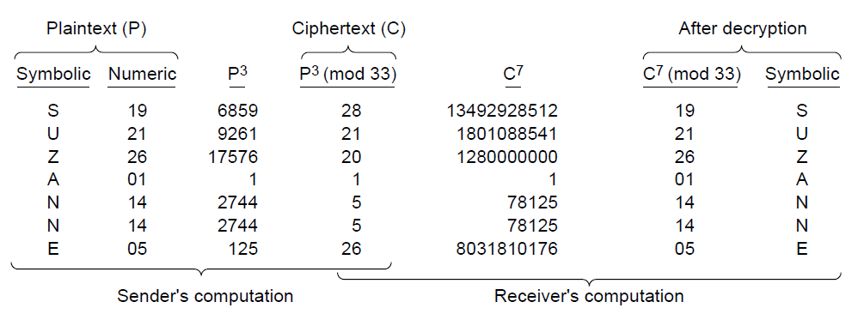
An example of the RSA algorithm
Typical values of e are 3, 17, and 65537 (=2¹⁶+1)

Slide 28
The Security of RSA
Approaches to attack the RSA algorithm are:
  Brute force: This involves trying all possible private keys.
  Mathematical attacks: There are several approaches, all equivalent in effort to factoring the product of two primes.
    Factor n into its two prime factors. This enables calculation of ø(n) = (p-1) x (q-1), which, in turn, enables determination of d = e⁻¹ (mod ø(n)).
    Determine ø(n) directly, without first determining p and q. Again, this enables determination of d = e⁻¹ (mod ø(n)).
    Determine d directly, without first determining ø(n).

Slide 29
Speed of RSA
In hardware, RSA is about 1000 times slower than DES.
Manufacturers have also implemented RSA in smart cards; these implementations are slower.
In software, DES is about 100 times faster than RSA.

Slide 30
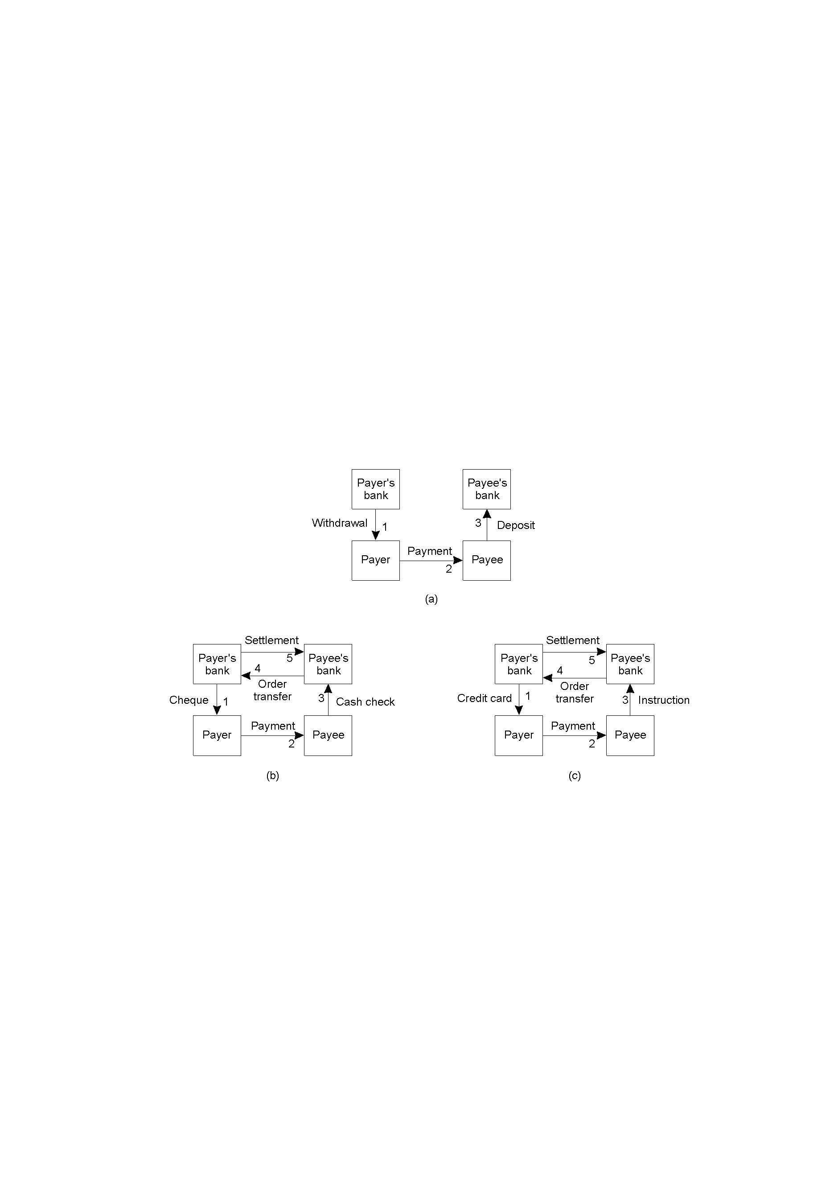
Asymmetric RSA
Applications – Electronic Payment
Payment systems - based on direct payment
  Paying in cash.
  Using a check.
  Using a credit card.

Slide 31
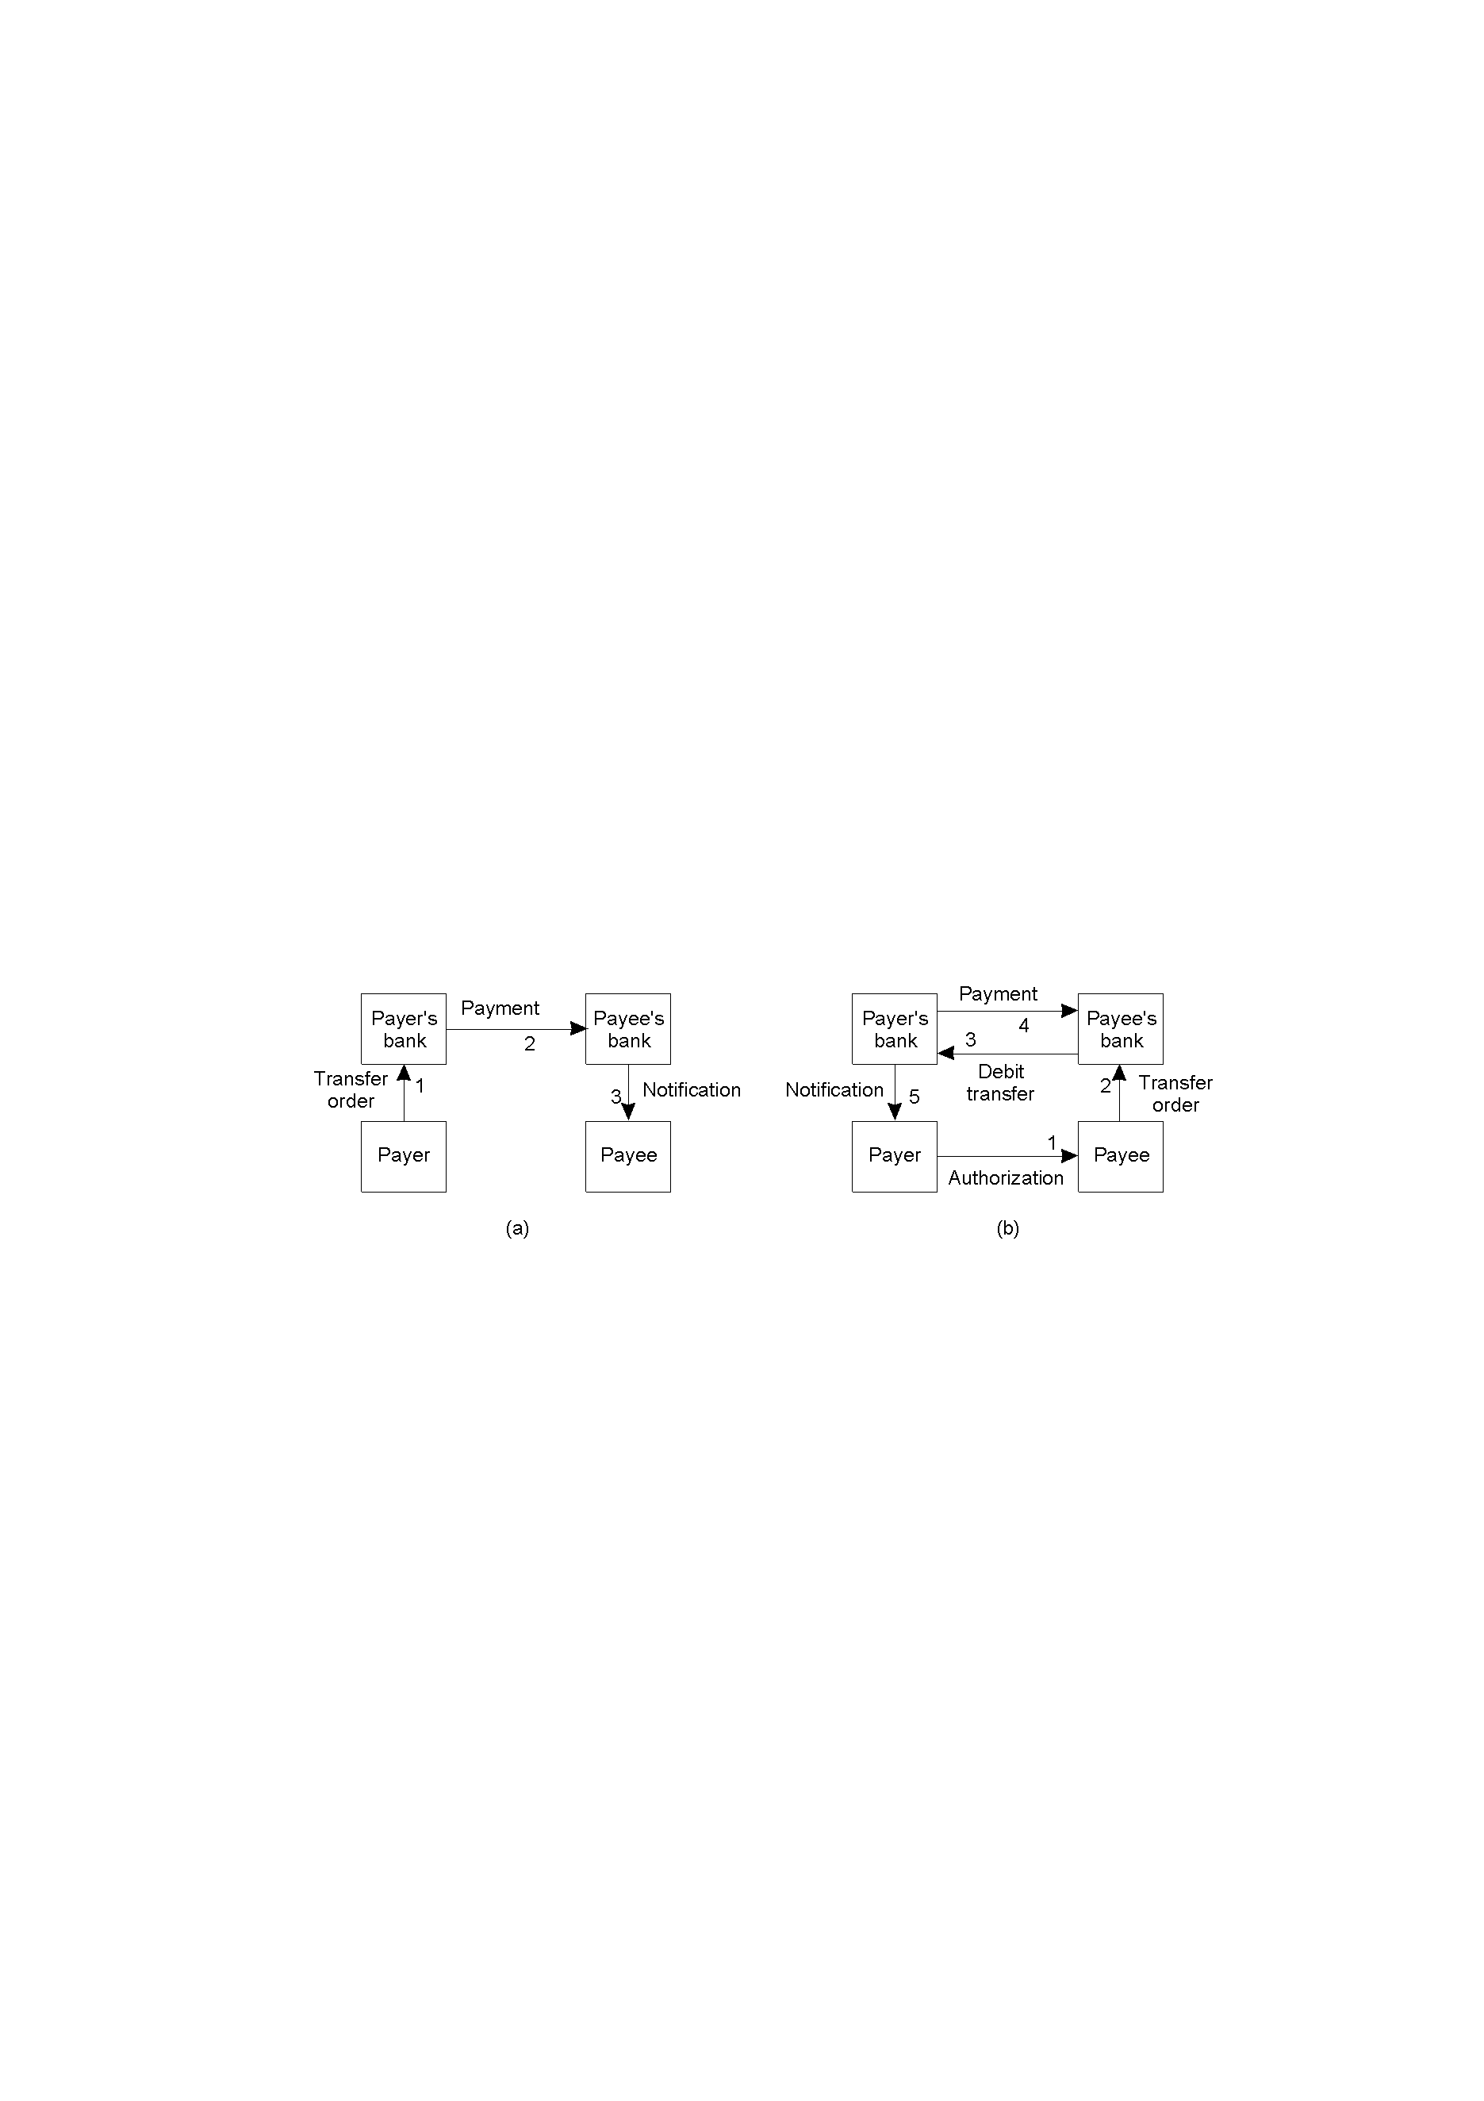
Asymmetric RSA
Applications – Electronic Payment
Payment systems based on money transfer between banks.
  Payment by money order.
  Payment through debit order.

Slide 32
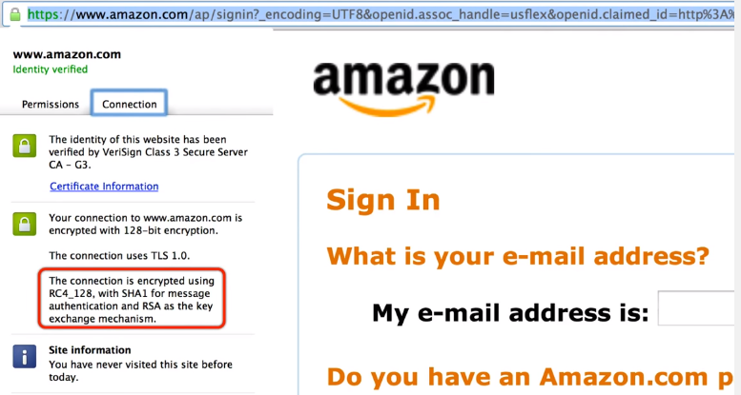
Hybrid Cryptography

Slide 33
Summary
Advantage of private/secret key cryptography is that it provides better secrecy but needs prearranged key exchange.
Advantage of public-key cryptography is that it allows for secrecy between two parties who have not arranged in advance to have a shared key (or trusted some third party to give it to them).
Disadvantage is overhead and speed.
Therefore, in practice, hybrid systems use public-key to establish session key for private key !!

Slide 34
Digital Signature

Slide 35
Digital Signature for Message Integrity and Confidentiality
  Encryption protects against passive attack (eavesdropping).
  A different requirement is to protect against active attack (falsification of data and transactions).
  Protection against such attacks is known as message authentication.
  Confidentiality insures that messages cannot be intercepted and read by eavesdroppers.
  Message integrity insures that messages are protected against modification.
For a conventional signature, there is normally a one-to-many relationship between a signature and documents. For a digital signature, there is a one-to-one relationship between a signature and a message.

Slide 36
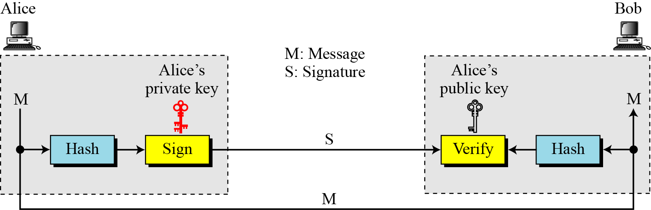
Digital Signatures
Digital signatures allow the world to verify I created a piece of data
  e.g. email, code
It is created by encrypting a hash of the data with my private key
This hash can then only be decrypted by my public key

Slide 37
Principles of Digital Signature
  User A signs digitally a message m using cryptographic hash of the message m with the private key of A and attach it to the message m.
  Anybody can then decrypt A’s digital signature using A’s public key and compare it with the cryptographic hash of the message m to verify that:
    m was signed by A and
    m was not altered.

Slide 38
Digital Signature for Assurance
Consider the situation where Bob has just sold Alice something for 500 Birr through a deal that is made by E-mail
Alice sends an E-mail accepting to pay 500 Birr
Two issues need to be taken care of in addition to authentication
  Alice needs to be sure that Bob will not modify the amount and show that Alice promised to pay more than 500 Birr
  Bob needs to be sure that Alice will not deny that she sends the message
If Alice signs the message digitally, the two issues will be solved
There are several ways to place digital signatures
One popular way is to use public-key cryptosystem such as RSA

Slide 39
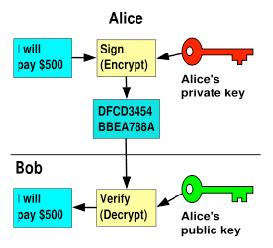
Digital Signature for Assurance

Slide 40
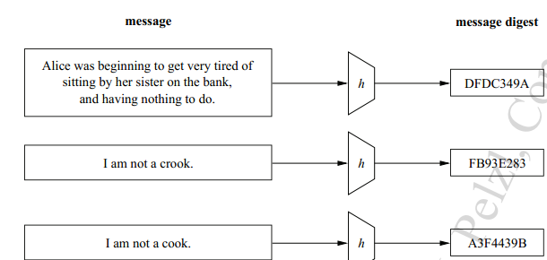
Digital Signature Schemes
Using Public Key
  RSA Digital Signature Scheme
  ElGamal Digital Signature Scheme
  Schnorr Digital Signature Scheme
  Digital Signature Standard (DSS)
  Elliptic Curve Digital Signature Scheme
Using Message Digest
  MD4 family
    MD4, MD5..
  SHA family
    SHA1, SHA2, SHA3…
  RIPEMD

Slide 41
Digital Signature Using Public Key
Notation: K_{X}^{- :} Private key of X
K_{X}^{+ :} Public key of X
When Alice sends her message m to Bob, she encrypts it with her private key K_{A}⁻(m)
If she wants to keep the message content a secret, she can use Bob’s public key and send K_{B}⁺(m, K_{A}⁻(m))
Alice is protected against modification by Bob since if Bob produces m’, he has to find K_{A}⁻(m’)

Slide 42
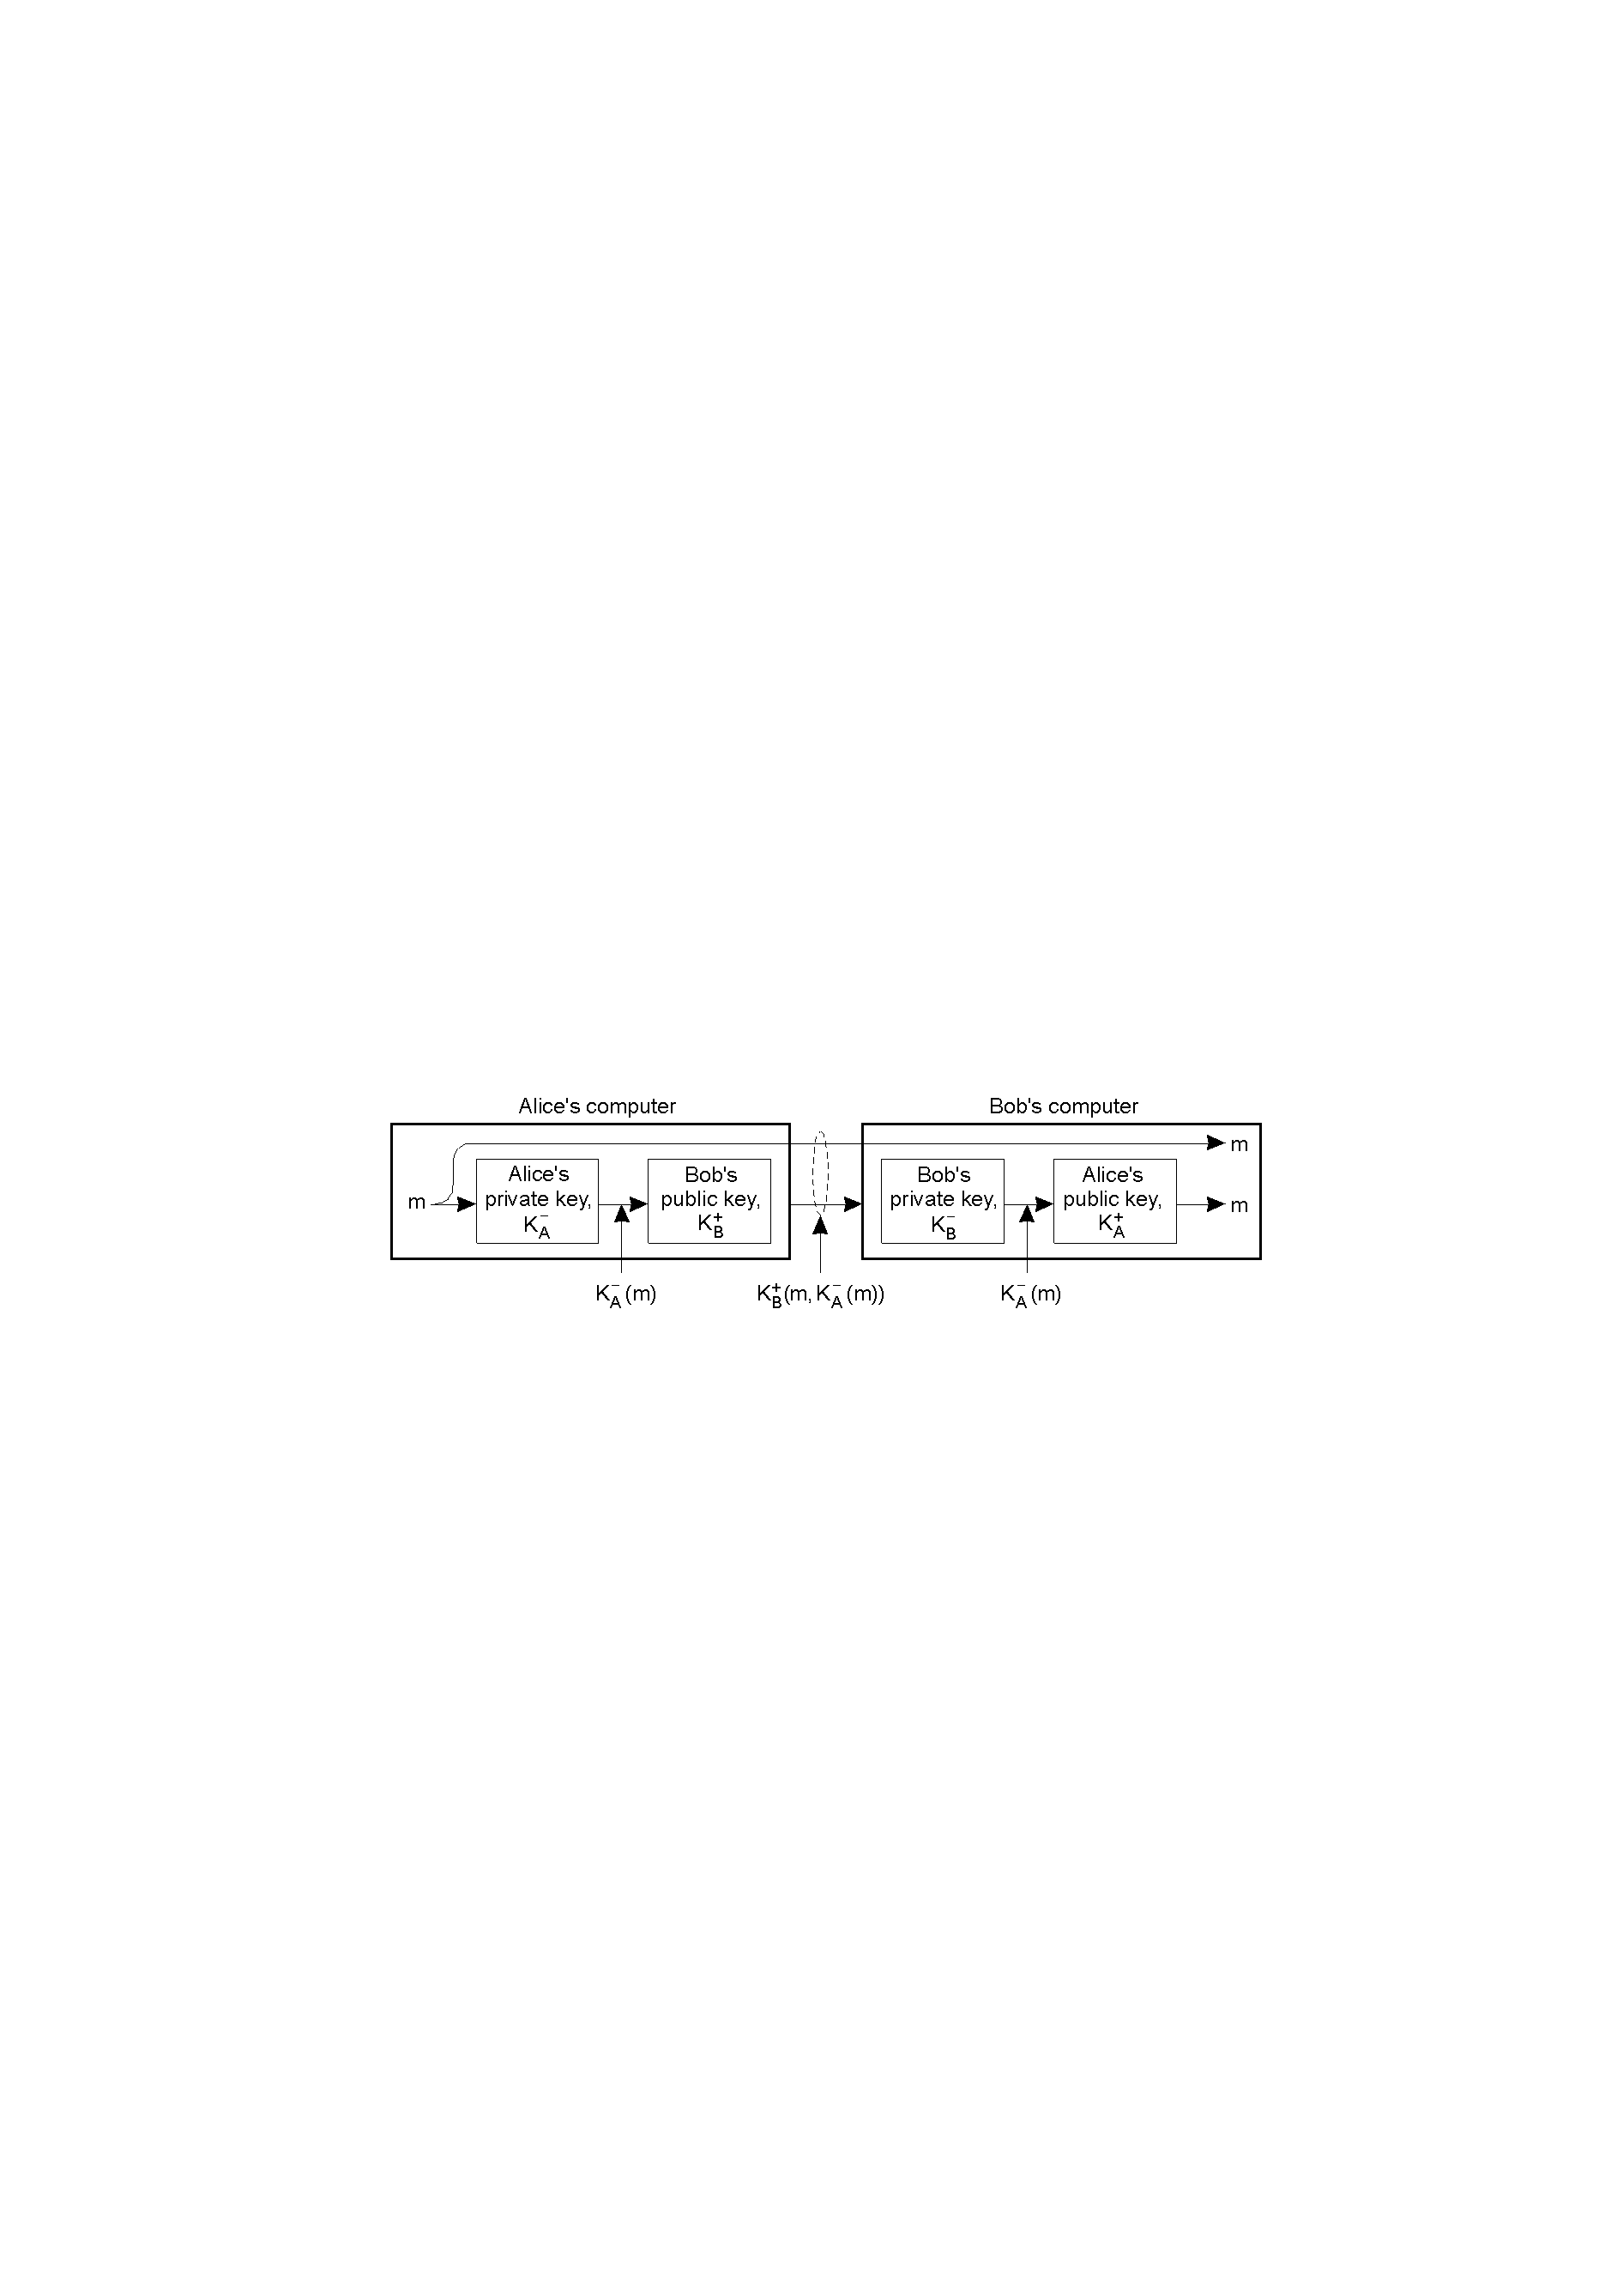
Digital Signature Using Public Key…

Slide 43
Example
As a trivial example, suppose that Alice chooses p = 823 and q = 953, and calculates n = 784319. The value of φ(n) is 782544. Now she chooses e = 313 and calculates d = 160009. At this point key generation is complete. Now imagine that Alice wants to send a message with the value of M = 19070 to Bob. She uses her private exponent, 160009, to sign the message:
Alice sends the message and the signature to Bob. Bob receives the message and the signature. He calculates
Bob accepts the message because he has verified Alice’s signature.
13.<number>

Slide 44
Digital Signature Using Message Digest
Hash/Message Digest: Short “signature” of the message, 128–512 bits, that depend on entire message
- Example: MD5 (Message Digest version 5)
H = H(m) is sent along m, where H is a cryptographic hash function
K_{A}⁻(H(m)) (or K_{B}⁺(m, K_{A}⁻(H(m)))) is sent so that Bob knows that it comes from Alice by decrypting it
Bob hashes the message m and compares it with H that he has received from Alice

Slide 45
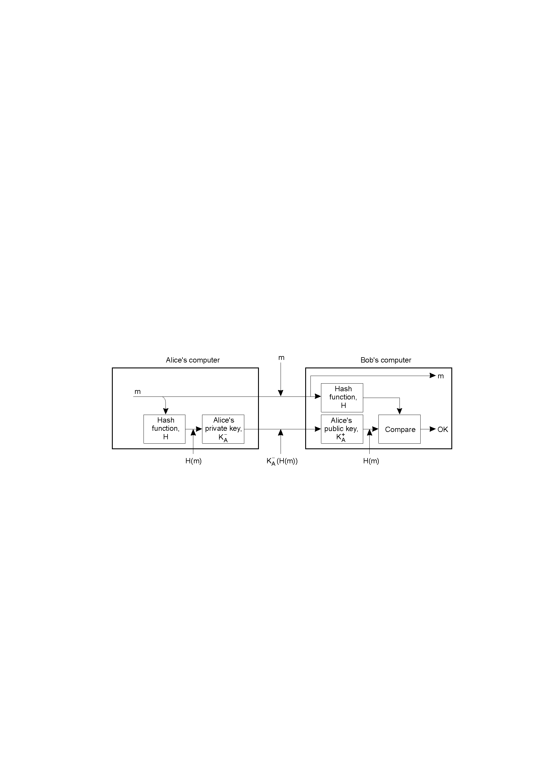
Digital Signature Using Message Digest…

Slide 46

Key Distribution
Announce public key on website or local newspaper….

Slide 47
Key Distribution:
Verifying Someone’s Public Key
Even with public-key cryptosystems and digital signatures, we still have the problem of authentication: binding users to keys.
Early days articles envisioned phonebook-like database with Name and Public Key entries.
  Problem: How secure is that database itself?
Attacker can put in his own key for someone else, and start signing fake contracts (and even checks!).
Maybe we can secure the phonebook, but then it kills the idea of keys widely and easily available (publicly).

Slide 48
Key Distribution: Problems
Distribution of a key is a difficult matter!
For a symmetric cryptosystem, the initial key must be communicated along a secured channel(?)
For public key, we need a body that certifies the public key is that of the party we need to communicate with
Solution: Certification/Certificate Authority (CA) that signs (certifies) the public key

Slide 49
Certification
The critical thing is that the name in the certificate must match the assumed name.
Common solution to public key distribution today is to have trusted third party to sign the user’s public encryption key.
A certificate is a public key and some naming “stuff”, digitally signed by someone you trust (third party) - Certification Authority (CA).
Remark: Just because they are CAs doesn’t mean you should trust them.
Resulting certificate will contain information like user’s name/ID, user’s public key, name of CA, start date of certificate, and length of time it is valid.
User publishes certificate with the X.509 standard (for formatting certificates).

Slide 50
Certification: Associated problem
An important issue is the durability of certificates
Life long certificates are not feasible
Therefore, we need a way to revoke certificates
  Certificate Revocation List (CRL) published regularly
  Problems
    Vulnerability between the publishing and the request for revocation
    Restricting the lifetime of a certificate
    A client contacts the certification authority for each public key, checks whether it is valid or not
  Solution → Key Distribution

Slide 51
Key Distribution
Most important component in secure transmission.
  A selects a key and physically delivers it to B.
  A trusted third party key distribution center (KDC) selects a key and physically delivers it to A and B.
  If A and B already have a viable key, it can be used to distribute a new key.
  If A and B have a secure link to KDC, can receive the key through that channel.

Slide 52
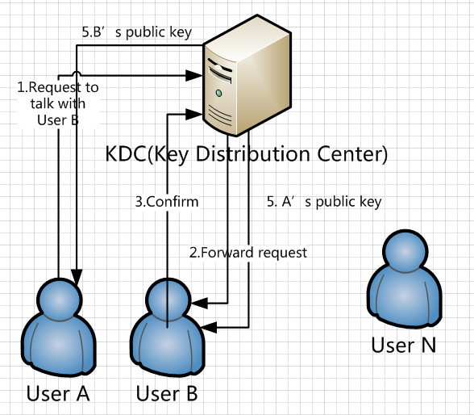
Key distribution..

Slide 53
Key Distribution…
Manual delivery is straightforward for link encryption, challenging for E-T-E
The number of keys grows quadratically with the number of endpoints (n*(n-1)/2)
  Further complexity for application/user level encryption
KDC a good alternative
  Only n master keys required

Slide 54
Decentralized Distribution
No need for KDC to be trusted and protected
Any two nodes can establish a session key
  Needs n(n-1)/2 master keys
  Can generate any number of session keys
Key distribution protocol

